Slide 1
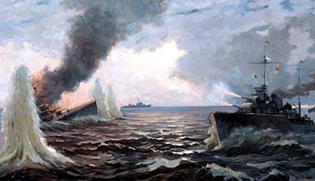
The Pacific Navy
And its contribution into our victory.
Gurkovsky Alex, 10 “B” Form, Gymnasia №1, Nakhodka, Primorsky Region

Slide 2
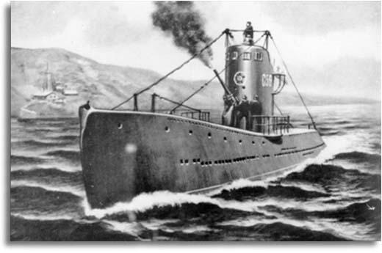
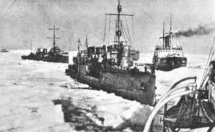
The Soviet Pacific Navy was a great importance for our glorious victory. It has 2 cruisers, 1 leader, 12 destroyers, 78 submarines, 29 patrol ships, 10 mine-layers, 52 minesweepers, 49 cutters - submarine hunters, 204 torpedo cutters, 1618 aircrafts, 43 landing crafts at its disposal.
Undoubtedly, I am proud of fearlessness and courage of our fellow countrymen. Nobody will deny, that Pacific Navy restrained Japanese Navy and fought against German Navy in The Black, Baltic and North seas successfully . We remember their unexampled feats.

Slide 3
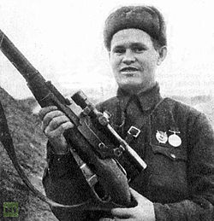
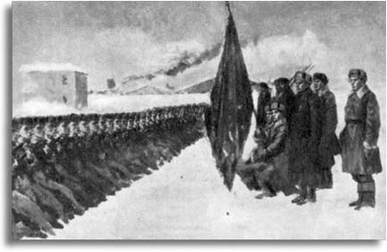
Not only ships in the Pacific Navy participated in the battles of World War II but also people, who served in Soviet Marines and Navy. Those people struggled against Nazi army in the Battles for Sevastopol, Moscow, Kursk, Stalingrad and some other cities and towns.
Vasily Grigoryevich Zaytsev is one of the most famous snipers and heroes of Stalingrad from Soviet Pacific Naval Infantry.
Names of Glorious pacific sailors and marines such as A. A. Lobchenko, V. G. Zaitsev, M. A. Panikahi and I. I. Pontyar added many bright, unfading pages into the history of The World War II.

Slide 4
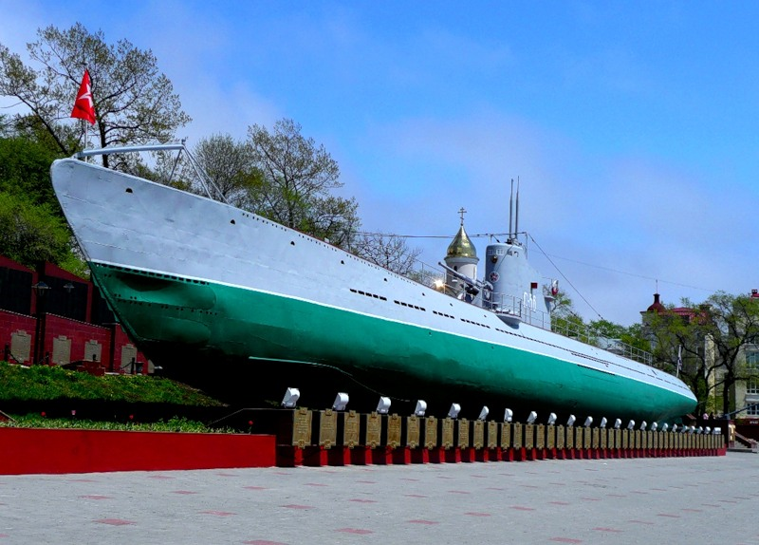
S-56 is a legendary Pacific Navy’s submarine which sank German ships in The Baltic sea.
You can see this famous Memorial to submarine S-56 on Karabelnaya Naberezhnaya in Vladivostok .

Slide 5
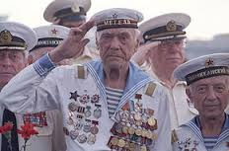
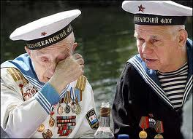
In honour of the veterans of The Pacific Navy I dedicate this synkveyn:
Victory
Bloody, severe
Glorifies, inspires, exalts
No one is forgotten, nothing is forgotten
Memory.

