Slide 1
Saint - Petersburg
School № 180 presents a booktrailer on the book
The Chronicles of Narnia
by
Lewis, Clive Staples
2015

Slide 2
My Favourite Book

Slide 3
Lewis, Clive Staples

Slide 4
The Chronicles of Narnia

Slide 5
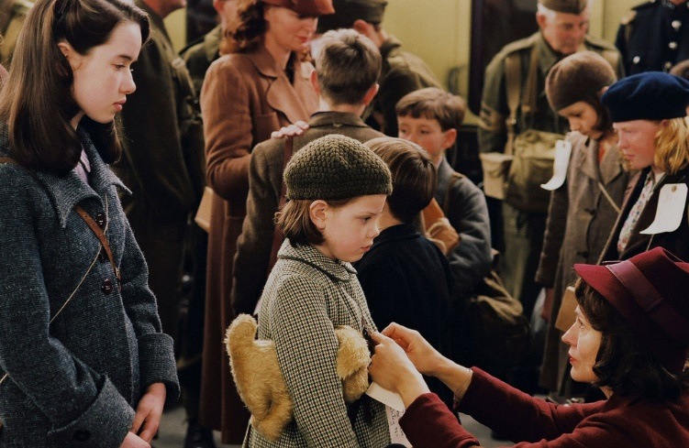
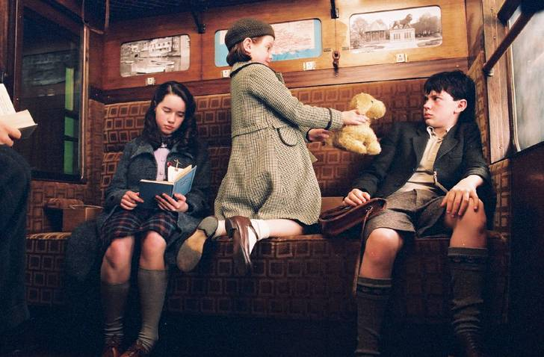
Outside the Second world war. Four children (Peter, Susan, Edmund and Lucy Pevensie), live with an elderly Professor in the village, while London, where their parents remained, exposed to the air raids of the Nazis.

Slide 6
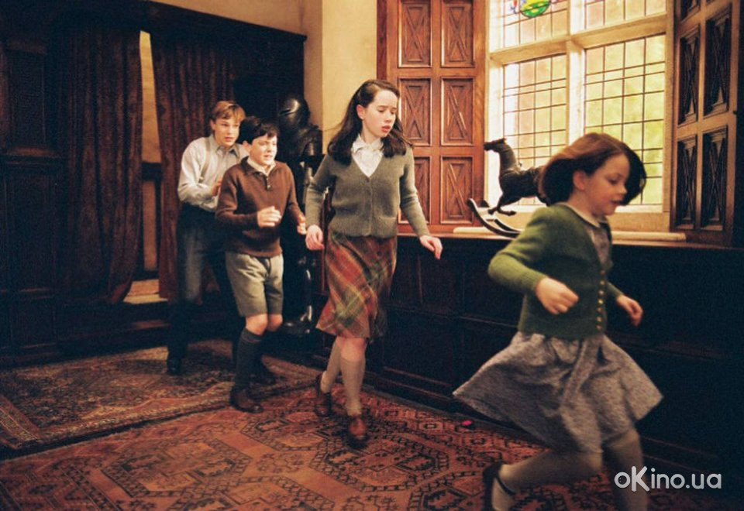
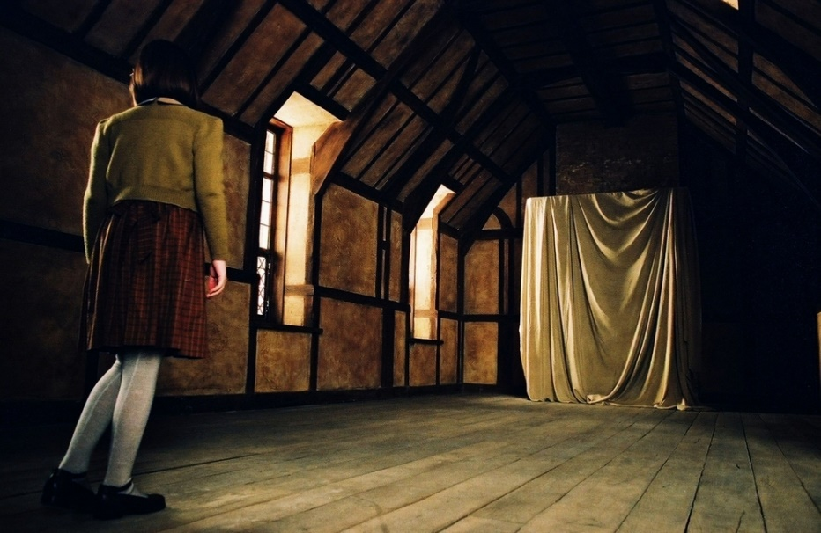
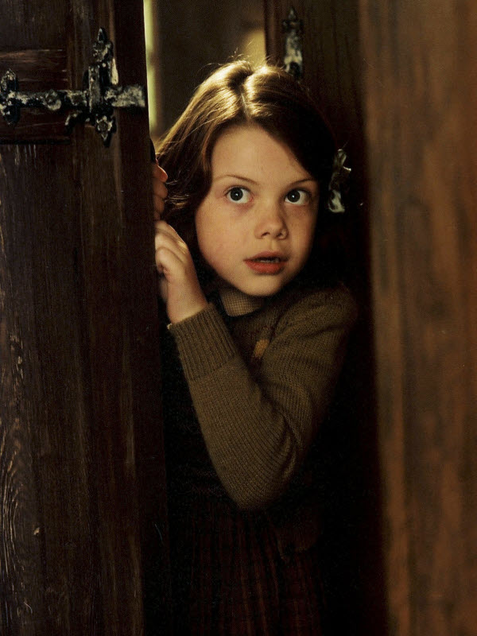
During the game of hide-and-seek, Lucy discovers a magical wardrobe at the Professor’s house.

Slide 7
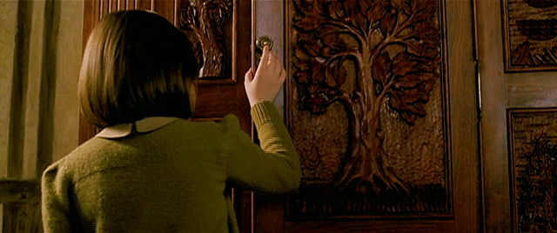
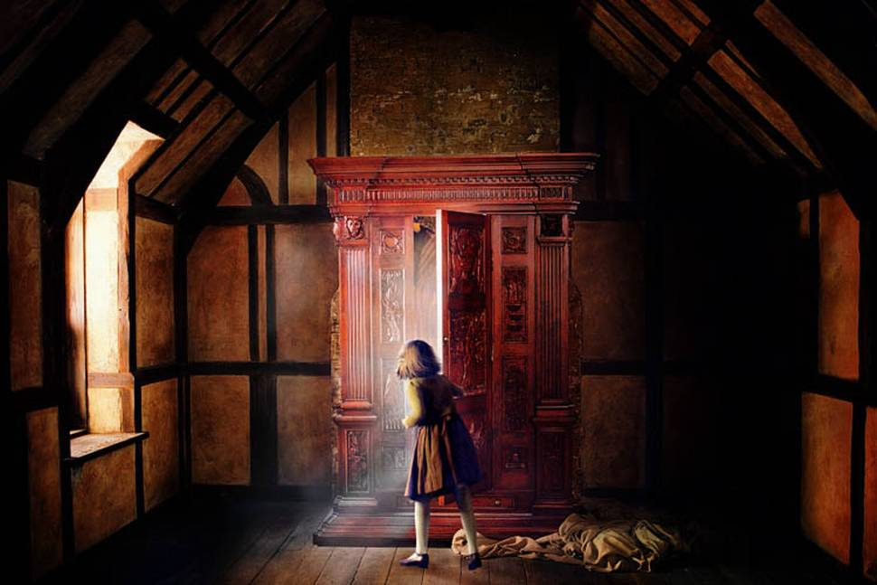
.
The wardrobe that the four Pevensie children discover is more than just a place to hang clothes. It is a magical portal to the land of Narnia

Slide 8
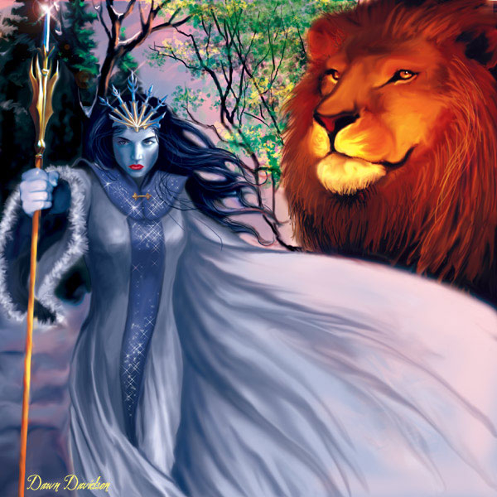
The wardrobe in the Professor's house is a portal through which you can get into a wonderful fairy land called Narnia, inhabited by many incredible creatures and people with magic powers

Slide 9
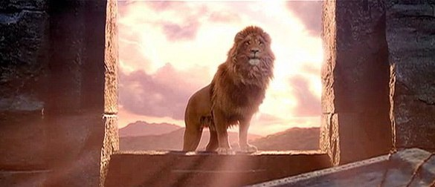
In this wonderful fairy land children meet Aslan, the wise and mighty Lion who is the King of Narnia

Slide 10
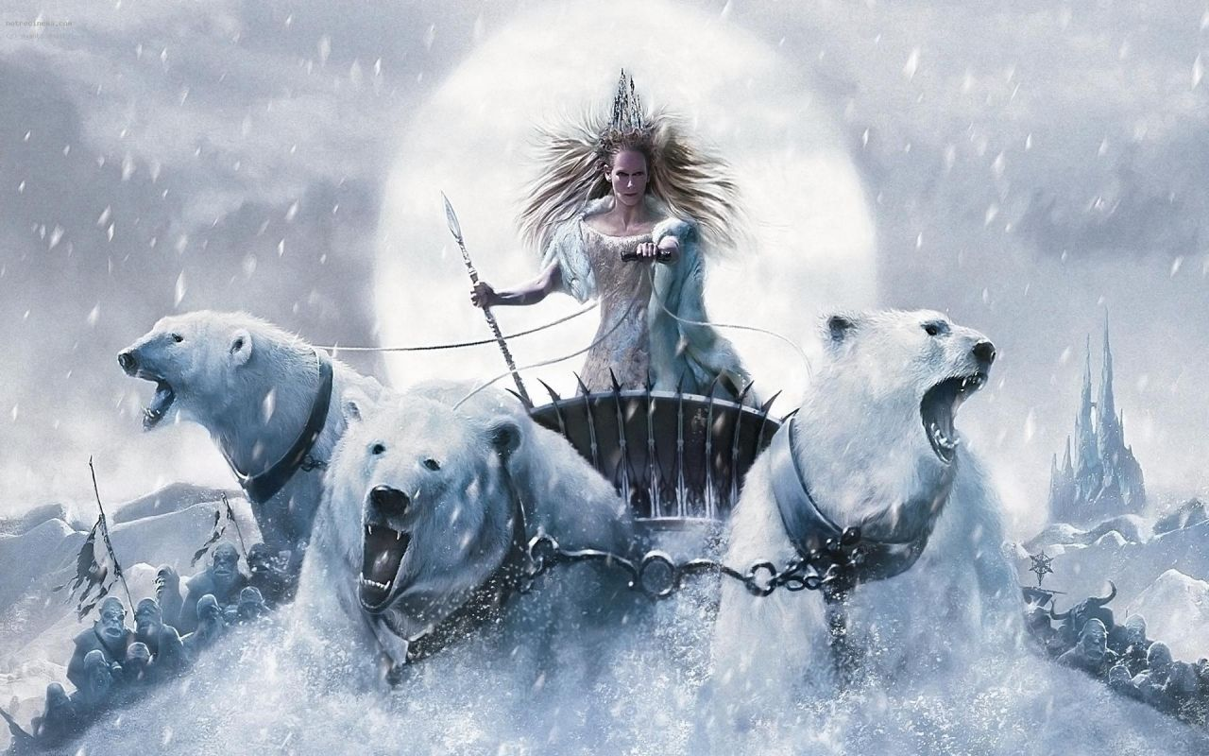
They meet the White Witch who wants to rule the kingdom and has made it always winter and never Christmas.

Slide 11
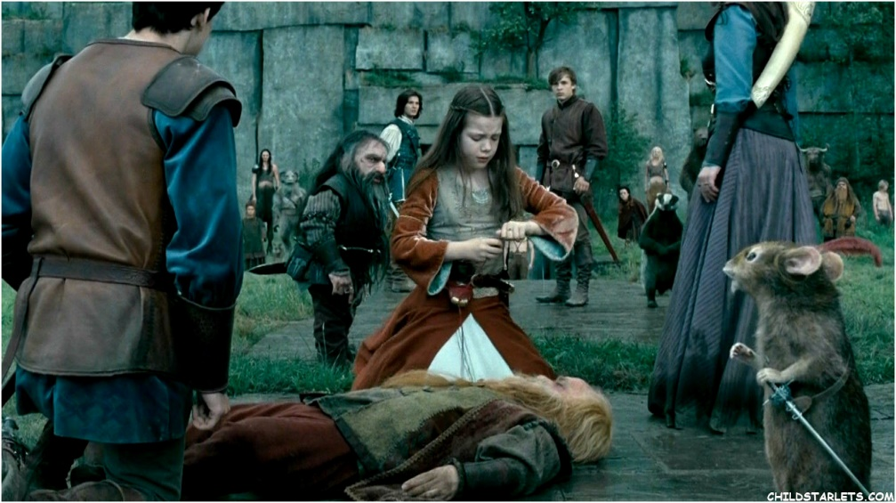
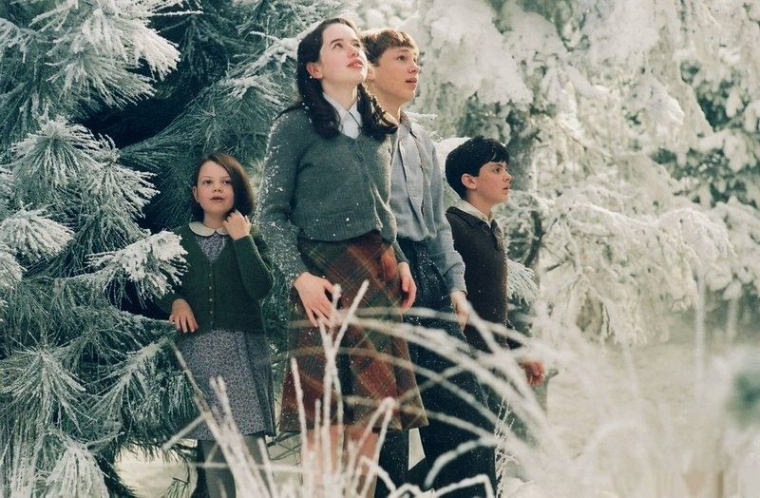
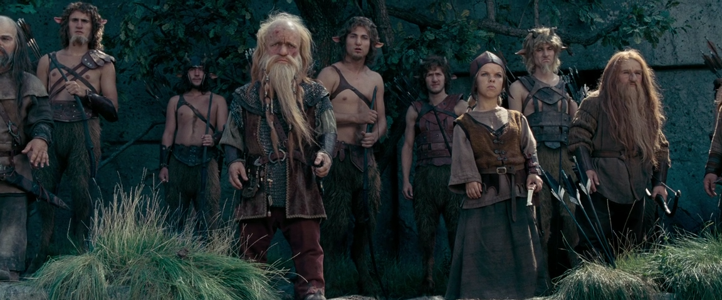
The children meet a host of human and animal friends and learn about loyalty, kindness and the consequences of actions taken as they help save the kingdom.

Slide 12
The Chronicles of Narnia

Slide 13
Read this book. You will have a lot of fun!

Slide 14
An English teacher
Elena Vasilievna Vasilieva
and the student of the 9th form
Anastasia Verman
worked over the booktrailer.
Software the slide show, soundtrack and stills from the movie “The Chronicles of Narnia” were used in this booktrailer

